Slide 1
“Villi be okay?” Diagnosis and management of Pediatric Celiac disease
Jess Stafford, CPNP
Division of Pediatric gastroenterology

Slide 2
Before we begin…
Go to app.gosoapbox.com
Code: psv

Slide 3
Learning Objectives
1. Define celiac disease and its symptoms
2. Describe incidence, prevalence and management of celiac disease
3. Identify and develop a staged work up with testing and referral

Slide 4
Disclosures
None ☺

Slide 5
History of celiac disease
Wheat began being cultivated in the fertile crescent about 8000 BC.
Gradually migrated to Europe around 600 BC
First description of celiac disease in Greece by Areteaus in first century; used to call them “Coeliacs”
1800 years later, Pediatrician named Samuel Gee in England gave first full description
Antibodies first found in 1960’s
Notes:
-to best understand where we are now, helpful to look at where we came from in terms of the development of celiac disease
-just to state the obvious; wheat contains the protein gluten
-celiac disease is a permanent intolerance to gluten

Slide 6
Notes:
-Described by Dr. Samuel Gee in 1888 report entitled “on the Coeliac Affection” – anemia, cachexia, diarrhea, and developmental delay in children. (Term “coeliac” derived from Greek word for abdominal)
-Banana babies- This was an idea started by Dr. Sidney Haas at this time.
So the idea was because [the children] are having diarrhea—because that was the main manifestation of celiac disease at that time—and because they knew that with diarrhea you lose some minerals, in particular potassium, empirically they decide for bananas. Why? Because they’re filled with astringent, so in other words they make you constipated, so they try to counterbalance the diarrhea and…because they are rich in potassium. So that’s the reason why they decided to focus on bananas and they give you enough calories to stay afloat. And of course, eating bananas and nothing else, you are gluten free. And you know—surprise, surprise—these kids were surviving on that diet.”
-1940s- Dutch pediatrician noticed clinical improvement of his patients during the Dutch famine (during which flour was scarce). He noticed that the shortage of bread led to a significant drop in the death rate among children affected by celiac disease from greater than 35% to essentially zero
So now that we have looked at how the diagnosis of celiac disease has evolved over time, that begs the question, what exactly is celiac disease?

Slide 7
What is celiac disease?
Immune-mediated enteropathy caused by a permanent sensitivity to gluten (in wheat and related proteins in barley and rye) in genetically susceptible individuals
Can present with GI and/or non-gastrointestinal symptoms
May also occur in asymptomatic individuals who have conditions that are associated with celiac disease
Notes:
-Celiac disease is a lifelong sensitivity to gluten in genetically susceptible individuals that results in characteristic damage to the small intestine.
-Gluten is a general term for the storage proteins found in wheat, barley, & rye
It is characterized by a variety of clinical GI and non-GI manifestations, which may begin in either childhood or adult life
Some individuals are completely asymptomatic & we will discuss conditions associated with celiac disease in a few slides

Slide 8
“Mommy? I have a tummy ache ☹”
Notes:
-So I suspect a lot of us see this patient and family all too often in practice
- And while I recognize there may be various diagnoses to think about, as gastroenterologists & pediatricians celiac disease should always be considered

Slide 9
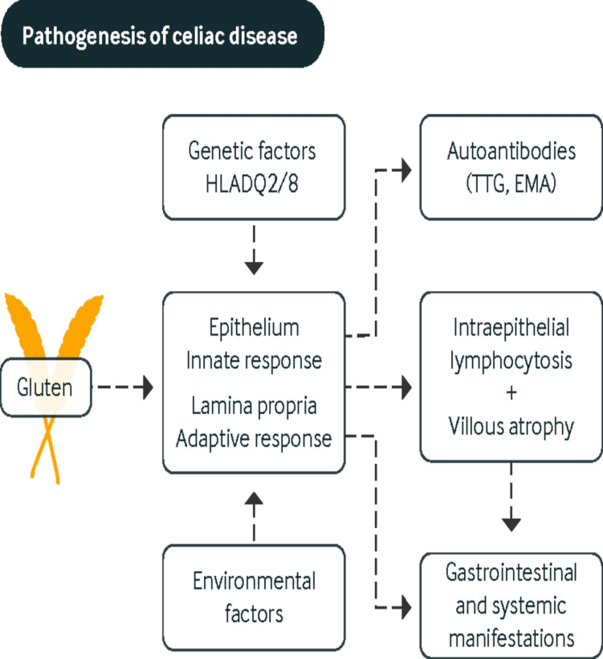
Pathophysiology of celiac disease
Notes:
-So as I mentioned earlier, it is caused by an immune response to gluten
-Both exposure to gluten and the presence of the human leukocyte antigen (HLA) DQ2/DQ8 genes are necessary, but not sufficient for development of celiac disease
-Unknown environmental factors,
stress, and other unidentified
genes are also crucial for the
development of the disease
So how prevalent is celiac disease?

Slide 10
Epidemiology
Epidemiologic studies in Europe and US indicate that CD is common and may occur in 0.5-1% of the general population
Female predominance 2:1
Long delays between onset of symptoms and diagnosis often occur and the condition remains underdiagnosed
Prevalence in children in the U.S. is estimated to be 1:100 (APGNN handbook)
Notes:
-Some of the more important numbers to remember here are:
Studies have shown a rate of occurrence of approximately 0.5-1% of the general population
-Thought to be a prevalence of approximately 1 in 100 children in the US
In addition to these some other important ones to consider include:
-It is estimated that 80-85% of cases are undiagnosed
-Current trend is delayed onset of symptoms and older age at diagnosis
50% of older children/adults may have no GI symptoms at time of diagnosis
30% of adults with celiac disease may have had a previous diagnosis of irritable bowel syndrome
-higher incidence in Caucasians with a female predominance in general

Slide 11
Symptoms
Gastrointestinal
Non-gastrointestinal
Diarrhea
Poor weight gain
Abdominal pain
Vomiting
Constipation
Abdominal distension
GERD
Bloating
Dermatitis herpetiformis
Dental enamel defects
Apthous ulcers
Osteopenia/osteoporosis
Short stature
Delayed puberty
Iron-deficient anemia unresponsive to treatment with oral iron (well documented in adults only)
Notes:
-In terms of symptoms, GI symptoms are typically the most obvious, which prompt a further workup
-However, important to remember celiac disease can present with non-GI manifestations as well
-As you can see, with really any GI complaint, celiac disease could be considered
-Many non GI manifestations are listed here and could also include fatigue
-The iron-deficient anemia unresponsive to treatment with oral iron is well documented in adults only

Slide 12
Dermatitis herpetiformis
Notes:
-This is an uncommon autoimmune cutaneous eruption that is a manifestation of gluten sensitivity
Affected patients typically develop pruritic inflammatory papules and vesicles on the forearms, knees, scalp, or buttocks
Typically responds well to treatment which includes dapsone and a gluten free diet being the primary interventions
Has been shown can affect up to 10% of patients with celiac disease
Next slide: In addition to the GI and non-GI manifestations, there is also consideration regarding neuropsychiatric symptoms that may be seen

Slide 13
Neuropsychiatric symptoms
Fatigue
Headaches
Seizures
Cerebellar ataxia
Peripheral neuropapthy
Anxiety/depression
Behavioral problems
Notes:
-More research is being done regarding these symptoms
I am certainly not implying that every pediatric patient with behavioral problems, etc. should be tested or screened for celiac disease; just something to think about
Our colleagues at Children’ s National are conducting Neurologic retrospective & prospective studies to better determine the prevalence of neurologic, neuropsychological, and physiological symptoms in children diagnosed with celiac disease & to understand how a gluten free diet may affect these symptoms

Slide 14
Celiac Then & Now
Old School
New School
Notes:
-The point of this slide to show is that the classic presentation of celiac disease has really not changed over the years
-The toddler to the left hand side has obvious abdominal distension, buttock wasting, and likely evidence of malnutrition both physically and if you were to plot on growth chart
-The picture to the right hand side, shows a patient from today’s day and age with a very similar physical presentation

Slide 15
Conditions associated with an increased prevalence of CD
Type I diabetes (3-12%)
Autoimmune thyroiditis (3-7%)
Down Syndrome (5-12%; 33% asymptomatic)
Turner Syndrome (4-8%)
Williams Syndrome (8%)
Selective IgA deficiency (2-8%)
First degree relatives of celiac patients
Notes:
-As mentioned earlier, there are particular conditions that are associated with an increased prevalence of celiac disease
-These conditions increase the risk of developing celiac disease anywhere from 3-12%
Down syndrome and type 1 diabetes being the highest
Important to bear in mind that having relatives, especially 1st degree relatives with celiac disease increases the risk as well
Thought to be a 1 in 22 chance in 1st degree relatives and 1 in 39 chance for 2nd degree relatives
Next slide: so with all of this information, the next question becomes who should I screen?

Slide 16
Which patients should be screened?
Patients with…
First degree family or other close relative with biopsy confirmed celiac disease
Symptomatic patients
Asymptomatic patients who have conditions associated with CD (type 1 diabetes, Down Syndrome, etc.)
Recommended that asymptomatic children who belong to groups at risk begin around 3 years of age, provided they have had an adequate gluten-containing diet for at least 1 year before screening
Notes:
-When deciding who to test or screen for celiac disease, important to consider if they have a 1st degree family member with biopsy confirmed celiac disease
Obviously consider screening in your symptomatic patients
However, important to also consider those asymptomatic patients who have conditions associated with celiac disease
Can consider addition of HLA testing as well in particular clinical situations
-Although presence of one or more of these genes is necessary for celiac disease, it is not sufficient for disease development
-Can also be helpful if the patient is found to have neither of the genes, which excludes the possibility of celiac disease or developing it
Absence of HLA-DQ2/DQ8 = high negative predictive value; excludes possibility of developing celiac

Slide 17
What other diagnoses would you consider?
Go to app.gosoapbox.com and click on green discussion
Code: psv

Slide 18
Other differential diagnoses? Depends on presentation but may include the following….
Irritable bowel syndrome
Inflammatory bowel disease
Lactose intolerance
Small intestinal bacterial overgrowth
Infection (i.e. Giardia)
Functional constipation
Pancreatic insufficiency
(i.e. Cystic Fibrosis)
Notes:
-Important to consider other diagnoses as well depending on the presentation of the patient and their symptoms
What are some other differential diagnoses you would consider in a symptomatic patient?
Next slide→ once you’ve determined who to test, the next question is which test is most appropriate?

Slide 19
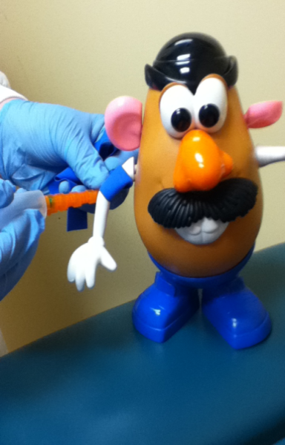
How to test?
Intestinal biopsy is still considered gold standard
Serological tests are used to determine for whom the procedure is indicated
TTG IgA
Total serum IgA (need to exclude IgA deficiency)
Endomysial IgA
TTG IgG recommended in individuals with low total IgA
If IgA deficient: TTG IgG
In children under 3: endomysial antibody
Notes:
-Should start with serological tests to determine if endoscopy with small intestinal biopsy is indicated
-Very important to obtain total serum IgA to exclude those with IgA deficiency. TTG IgG recommended in those individuals with IgA deficiency.
Approximately 2% of children with celiac disease will have a previously unrecognized IgA deficiency
Another situation seen in practice quite commonly is a weakly positive TTG IgA. We will discuss a case study later on regarding this.
Some may recommend EGD at that time, and some may recommend repeat screening blood work in approximately 6 months
Just very important if waiting to repeat screening blood work, to educate the family to have patient continue gluten containing diet

Slide 20
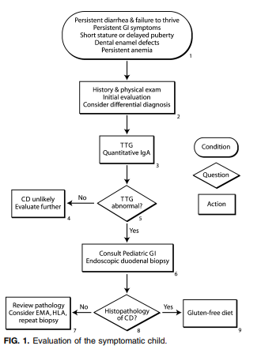
Evaluation of the Symptomatic Child
Please don’t- take gluten out of diet prior to endoscopy!!
For blood work and/or EGD to be considered accurate, need at least an equivalent of 1 slice of bread daily for at least 6-8 weeks prior
tTG IgA with ~ 95% specificity and sensitivity in identifying CD
Notes:
-A quick algorithm to refer for evaluation of the symptomatic child
-Biggest take away from this slide would be please do not recommend gluten free diet prior to endoscopy
-Experts agree there needs to be approximately an equivalent of 1 slice of bread daily in the diet for at least 6-8 weeks for blood work to be considered accurate
-Common issue seen in practice is where gluten will be removed out of diet by either parents or the patient prior to any testing

Slide 21
Genetic testing
HLA DQ2 and DQ8- only specific situations
Not a useful screening tool due to very low positive predictive value
High negative predictive value
Useful in patients on a gluten-free diet unwilling to undergo a gluten challenge
Useful in asymptomatic at-risk patients
Useful in those with questionable biopsy results
Notes:
As mentioned earlier, the high negative predictive value of the HLA testing does not diagnose celiac disease. In other words if testing is negative, celiac disease can be effectively ruled out
Can be somewhat helpful in a few clinical situations:
Patients on a gluten free diet unwilling to undergo a gluten challenge
Asymptomatic at risk patients
Those with questionable biopsy results
DQ2 gene is carried by 1/3 of the US population, but only 4% of these people develop celiac disease

Slide 22
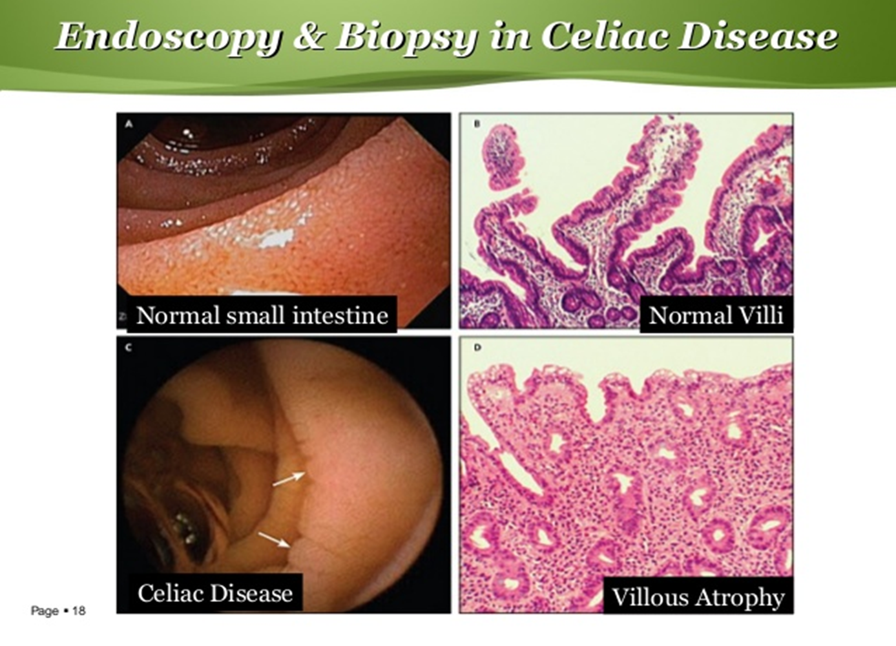
Notes:
So when I see patients and families back after their initial endoscopy as new diagnosis, I like to explain to patients and families when I see them in follow up for a new diagnosis patient that the villi are these finger like projections in the small intestine that help us absorb our vitamins, minerals, nutrients, etc. and in celiac disease these fingers are “chopped off”
The damage to the small intestine is progressive and characteristic changes seen on the intestinal biopsy can be staged
Stage 3 being villous atrophy
Typically the pathologist will report the changes seen on biopsies, stating that they are consistent with celiac disease

Slide 23
At a cellular level…
Notes:
-Also do not expect anyone to memorize this, but just included for your knowledge
Next slide: So when do we refer for EGD with small intestinal biopsy?

Slide 24
Endoscopy and biopsy
Duodenal biopsy in all patients with tTG IgA above the cutoff value
If suspicion remains high despite negative serologic testing
Repeat biopsy NOT routinely recommended to confirm diagnosis if a patient has improved clinically
Notes:
-For patients with TTG IgA above the cutoff value (normal being anything less than 4) (weak positive 5-9)
-Will refer for EGD for some patients where the suspicion for celiac remains high despite normal serologic testing
-Important to note that repeat biopsy is not generally recommended to confirm the diagnosis if a patient has improved clinically on a gluten free diet
-A second biopsy is really only reserved for patients who have had an unsatisfactory response to a strict gluten free diet

Slide 25
NASPGHAN guidelines for clinical diagnosis of CD
- Currently recommended that confirmation of the diagnosis of celiac disease requires an intestinal biopsy in all cases
Notes:
-clinical diagnosis in children on the basis of gastrointestinal symptoms alone was incorrect more than 50% of cases
-Radiological and other nonserological tests were also unable to separate those with or without villous atrophy.
-Important to remember this is a lifelong to a gluten free diet, which is why this is recommended to confirm.

Slide 26
European criteria for clinical diagnosis
-TTG of greater than 10x normal
-With a positive endomysial antibody
-with positive HLA typing (DQ2 and/or Dq8)
Notes:
-Every procedure is an opportunity for shared decision making
-If a child meets European guidelines (classic symptoms, TTG over 100, positive HLA typing and positive endomysial antibody) can have discussion with family regarding foregoing endoscopy and making the diagnosis

Slide 27
Case #1
Meet Henry:
9 year old boy with intermittent periumbilical abdominal pain for as long as parents can remember (at least 1-2 years)
Notes:
Now lets talk through some very plausible clinical situations you may encounter in practice

Slide 28
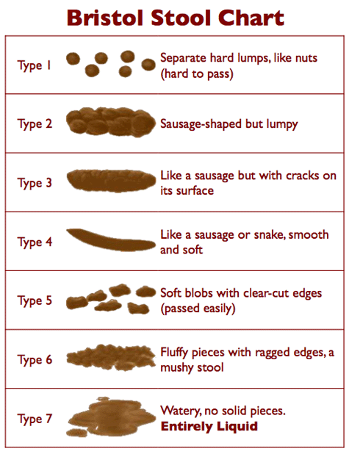
Other facts?
No diarrhea, stools are daily, Bristol 4-5
No rectal bleeding
Appetite is fair, picky eater per mother
Plays soccer, straight A student
FH: MGM-diverticulitis, IBS
Mother-Migraines

Slide 29
What else would you like to know (lab testing)?
H/H: 10.5/33, MCV 81
Comp Chem panel-all normal
ESR: 7
CRP: 0.5
Fecal Calprotectin: 68
H. Pylori stool: negative
TTG IgA: 65; IgA normal

Slide 30
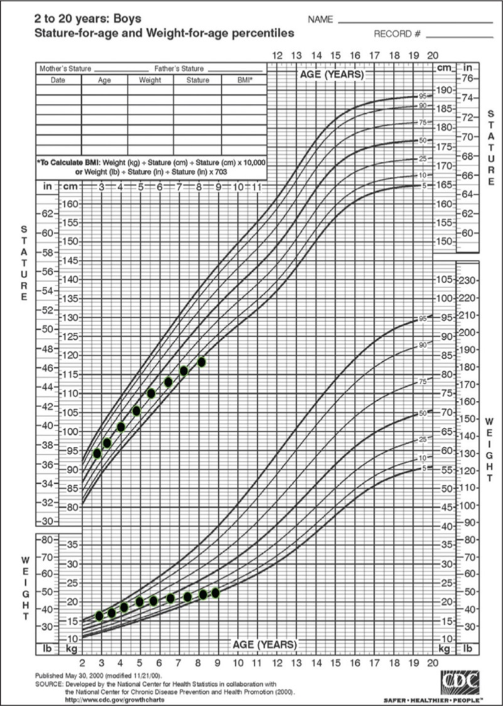
Notes:
-Very important to always look at growth chart and trends
-This growth chart is an excellent example of small trends noted over time that may clue the provider to pursue further workup
-This is more of an obvious example, but take away from this slide is to always remember growth!

Slide 31
Next steps?
Lets take a poll!
Go to app.gosoapbox.com and click on the purple quiz
Code: psv

Slide 32
Case #2
Meet Samantha.
13 Year old girl with 6 months of abdominal pain, non descript, non localized

Slide 33
HPI
Pain is not associated with eating, does not wake her from sleep
Stools every few days, bristol type 1-3. Straining as well.
No fevers, diarrhea, joint pain, vomiting, or rashes

Slide 34
What else would like you like to know?
Go to app.gosoapbox.com to add your idea in the green discussion
Code: psv

Slide 35
What else would you like to know?
They have tried Miralax on and off in the past, which does help but does seem that constipation reoccurs when discontinued
Weight has fluctuated up and down a few lbs, but no significant weight loss
Menarche- has not menstruated yet
No particular food triggers they have been able to put a finger on, other than possibly dairy
FMH- Mom with IBS and Hashimoto’s thyroiditis; Father with “GI issues” that he has not had checked out yet

Slide 36
What additional testing should we consider?
Could include basic screening blood work including CBC, CMP, ESR, CRP, celiac serologies, and thyroid studies
Would not recommend getting an abdominal xray
Upon further review of blood work:
TTG >100, normal total IgA
CBC, CMP, ESR, CRP, thyroid studies all unremarkable
Next steps?
Send to GI for endoscopy with small intestinal biopsies
Notes:
-added in TSH here as well given the constipation since we were obtaining screening blood work

Slide 37
Case # 3
Meet Avery.
3 year old female presenting to your office today for 2 months of loose stool

Slide 38
Upon further questioning….
Parents note she has had occasional constipation before this
No noted abdominal pain or vomiting
Recently completed antibiotic course for an ear infection
Picky eater in general and loves carbs, milk, and juices
PMH: reflux as an infant, otherwise healthy
FMH:
Mother with biopsy confirmed celiac disease
On exam: only notable for mildly distended abdomen

Slide 39
What else would you like to know?
Blood work:
Unremarkable CBC, CMP, ESR, CRP, TSH
IgA 91
TTG IgA 9
Endomysial antibody not done
Upon further review of growth charts from PMD, weight gain has fluctuated, although BMI 25th percentile
Stool studies??

Slide 40
Based on the blood work, what would you like to do?
Go to app.gosoapbox.com and click on the red poll
Code: psv

Slide 41
Would you like to…
Remove both dairy and wheat out of diet
Repeat blood work as it was only mildly positive
Refer to pediatric GI
Remove all wheat, barley, and rye out of diet
Notes:
- This is a good case for discussion
- Really depends on how significant the symptoms are
- for a child who is failing to thrive, I have a much lower threshold to send for biopsy
Would also consider obtaining endomysial antibody here. Studies show it is equally accurate to the TTG IgA, and some data suggests in patients 3 and younger it is actually more sensitive

Slide 42
Notes:
This is a helpful web based algorithm tool on naspghan.org to help clinical decision making in these particular situations

Slide 43
Who else has been asked this?
Well if I don’t have celiac disease, than why do I have symptoms when I eat foods that contain gluten?
Notes:
-By show of hands

Slide 44
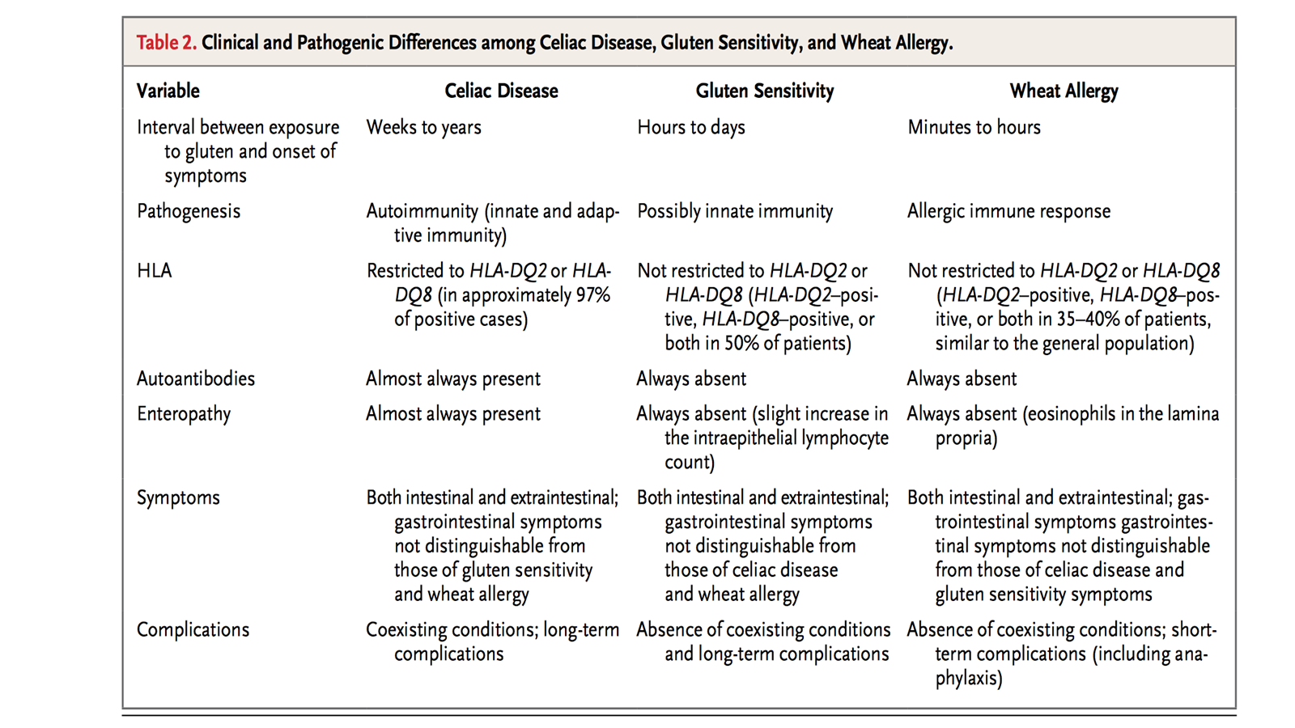
Celiac vs. Gluten Sensitivity vs. Wheat Allergy
Notes:
-Here is a helpful table to help differentiate between these three entities
Our allergists in the crowd can obviously speak better to wheat allergy
The two we focus on in GI are celiac and non-celiac gluten sensitivity
Non-celiac gluten sensitivity is a poorly defined syndrome characterized by a variable combination of intestinal and/or extraintestinal symptoms, typically occurring soon after the ingestion of gluten-containing foods and disappearing quickly upon their withdrawal.
Occurring in individuals where both celiac disease and wheat allergy have been excluded where appropriate

Slide 45
Gluten Free Diet: Overview
Celiac disease
Non-celiac gluten sensitivity
Treatment: GFD
Strict adherence to GFD: <10 mg/day
Lifelong: Yes
Consequence of non-compliance:
-Physical symptoms: Yes
-Intestinal damage: Yes
-Monitored by bio-marker
-Comorbidities: Yes
Treatment: GFD
Strict adherence to GFD: ????
Lifelong: ???
Consequence of non-compliance:
-Physical symptoms: Yes
-Intestinal damage: No
-Monitored by bio-marker:No
-Comorbidities: ?
Notes:
This helps to highlight the difference between celiac disease & non-celiac gluten sensitivity
In terms of comorbidities of unmanaged celiac disease, can include nutritional deficiencies, poor growth and/or bone health, and increased risk of enteropathy t-cell mediated lymphoma
Typically affects the small intestine
Thought to be a increased 5-fold risk in celiac patients; thought to be those non-compliant or untreated, and in the 30-40 year old population

Slide 46
Notes:
I’m sure we’ve had patients/families ask us about these options out there as well.
-While I don’t like to dismiss their interest in this, these are not well documented or supported in the literature

Slide 47
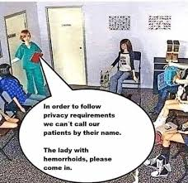
Notes:
-Before we discuss treatment and monitoring, just wanted to make sure everyone is still awake

Slide 48
Treatment
Only recognized therapy is lifelong adherence to a gluten-free diet
Notes:
-There is currently no medical treatment for celiac disease at this time.
Gluten free diet for life remains the only scientifically proven treatment available for individuals with celiac disease
-Even small amounts of gluten ingested on a regular basis can lead to mucosal damage

Slide 49
Dietary education with dietitian
Crucial given it is the treatment
Dispelling myths
Notes:
-patients should begin a gluten free diet only after a complete diagnostic evaluation, including serology & biopsy
-gluten free multivitamin typically recommended for newly diagnosed children and/or those patients with concerning gaps in their nutrition

Slide 50
Education highlights with dietitian
Education regarding what foods contain gluten (avoid wheat, barley, rye, oats– oats okay if labeled GF)
Label reading help
Cross contamination in the home
Notes:
- separate shelf to prevent falling contaminants
-Toaster: patient needs his/her own
-Cutting boards or plates with grooves (plastic) need to be replaced
-Colanders should be metal; plastic colanders can hold onto contaminants more easily
-Cooking: may use separate pan
-Wash everything before use
-Double dipping: do not share containers that are often double dipped with utensils and food (i.e. peanut butter, mayo, dressing, etc.)

Slide 51
Education highlights continued…
Alert the pharmacy: pharmacy should be aware in case medication is not gluten free
Non-food contamination
Play-doh, paper mache
Can buy gluten free play-doh
Lotion, sunscreen, chapstick, toothpaste, hairspray
Notes:
Important to alert child’s pharmacy regarding gluten free medications just in case
-Also need to think of non-food contamination in terms of hidden sources of gluten, especially for a patient with persistently mildly elevated TTG in spite of report of strict adherence to GFD

Slide 52
How about lactose??
Notes:
-Most children with newly diagnosed celiac disease will tolerate ingestion of lactose, particularly in moderate amounts
-Some parents may be avoiding dairy prior to diagnosis of celiac since they were suspecting lactose intolerance
-There can be a secondary lactose intolerance seen in patients with celiac disease, and once patient goes gluten free, most patients are then able to tolerate lactose in diet
-The lactase enzyme lives on the tips of the villi, so it would make sense that if the villi are damaged, there may be clinical symptoms of lactose intolerance
-Harder cheeses (i.e. parmesan), greek yogurt, etc. may be easier for them

Slide 53
Clinical course
Resolution of symptoms can occur within several weeks on a gluten-free diet
Normalization of small bowel biopsy may take 6-12 months, as well as normalization of tTG IgA
Although, some papers have recognized it may take even longer (closer to 12-24 months, possibly longer)

Slide 54
How to monitor?
At time of diagnosis, order routine screening blood work including CBC, iron studies, thyroid functions tests, CMP, 25-hydroxy vitamin D
Recheck tTG IgA after starting gluten-free diet approximately 4-6 months after starting to monitor compliance and response
Repeat routine screening blood work, if previously abnormal
Periodic visits for assessment of symptoms, growth, PE, and adherence to GFD
Support for confounding issues (i.e. anxiety, depression)
Notes:
There is little evidence on the most effective means of monitoring patients with celiac disease
Guideline committee recommends measurement of TTG after 6 months of treatment with a GFD to demonstrate a decrease in antibody titer as an indirect indicator of dietary adherence and recovery
Measurement of TTG is also recommended in patients with persistent or recurrent symptoms at any time after starting a GFD, as a rise in antibody levels suggest dietary non-adherence
Higher incidences of IBS in patients with celiac disease

Slide 55
How to monitor continued…
Assess for any nutritional deficiencies and supplement with gluten free multi-vitamin and other supplementation as needed
Baseline DEXA scan to evaluate for bone mineral density
Assess Hepatitis B status (if non-immune recommend booster and or repeat series)
Notes:
In terms of DEXA scan recommendations, there really is not strong evidence regarding when and how often to do this.
-Some will recommend to do it after one year of being gluten-free
-Others will do it at diagnosis for classic presentation of celiac (i.e. patient has lost a lot of weight, classic malabsorption)
-Also important to look at vitamin D levels in conjunction with this
In our patients with celiac and IBD for example, the exact mechanism is not known for Hepatitis B immunity. Likely that they never had immunity in the first place.
-Then there is also debate regarding whether to administer a booster or the entire series again.
Typically recommended that if there are no antibodies, will do the series.

Slide 56
Eating Higher-Than-Normal Levels Of Gluten During First Five Years Of Life May Increase Children’s Likelihood Of Developing Celiac Disease, Research Suggests
Notes:
-The study of “more than 6,600 newborns in the United States, Finland, Germany and Sweden born between 2004 to 2010,” all of whom “carried a genotype associated with type 1 diabetes and celiac disease,” revealed that “higher gluten intake was associated with a 7.2% increased risk of celiac disease per each additional gram or gluten per day.”
-This study was just recently published in JAMA

Slide 57
Future directions?
Possible vaccine candidate, Nexvax2
Notes:
ImmusanT, Inc., announced in its press release on January 2nd that its therapeutic vaccine candidate, Nexvax2, has been granted Fast Track designation by the U.S. Food and Drug Administration (FDA).
The FDA’s Fast Track is a process which speeds the review of drugs—a lengthy, multiyear process—to fill an unmet medical need and get important medications to patients sooner.
Currently, there is no FDA-approved drug for the treatment of celiac disease. The only course of action available to celiac patients is to adhere to a strict, gluten-free diet.
ImmusanT hopes Nexvax2 will change that reality by bringing their revolutionary therapeutic vaccine to the market sooner. Nexvax2 works by leveraging the body’s own immune system to treat celiac disease in patients with the HLA DQ2.5 gene (approximately 90% of celiac patients).
The concept is that patients would start with a small dose of the vaccine and gradually increase the dose, allowing the body to build up resistance to the problematic protein in gluten, without the associated negative effects of consuming gluten.

Slide 60
Thank you! Questions?

